Slide 1
INFO 656-01 Fall 2020 Feature Engineering
Week 13
Amir Imani

Slide 2
Homework feedback
ALWAYS do preprocessing steps like imputation in a pipeline
Otherwise, apply preprocessing steps only on training set not the whole data
Normalize data before PCA
Import libraries at the top
Once stablished n numbers of cluster, run clustering again with that number
Feel free to update read me file to reflect your work!
Take advantage of Git!

Slide 3
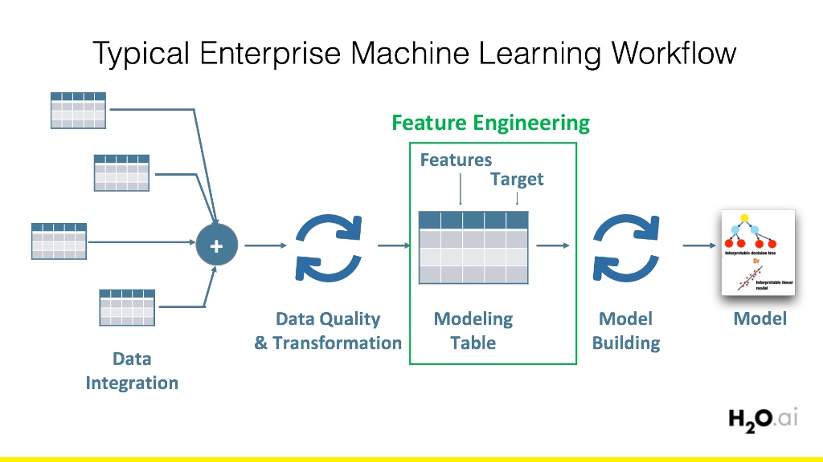
Feature Engineering
“ Coming up with features is difficult, time-consuming, requires expert knowledge. Applied ML is basically feature engineering” Anrew Ng
Notes:
All machine learning algorithms use some input data (usually in the form of structured features) to create outputs.
Algorithms require features with some specific characteristic to work properly.

Slide 4
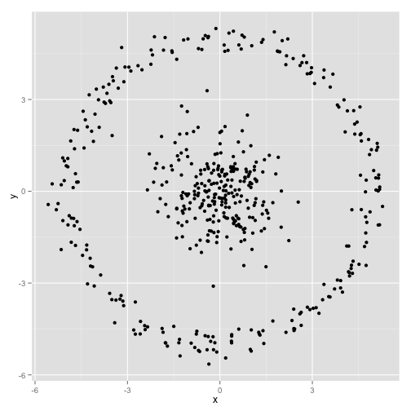
Feature Engineering
In the original space, can’t separate using linear classifiers
Notes:
All machine learning algorithms use some input data (usually in the form of structured features) to create outputs.
Algorithms require features with some specific characteristic to work properly.

Slide 5
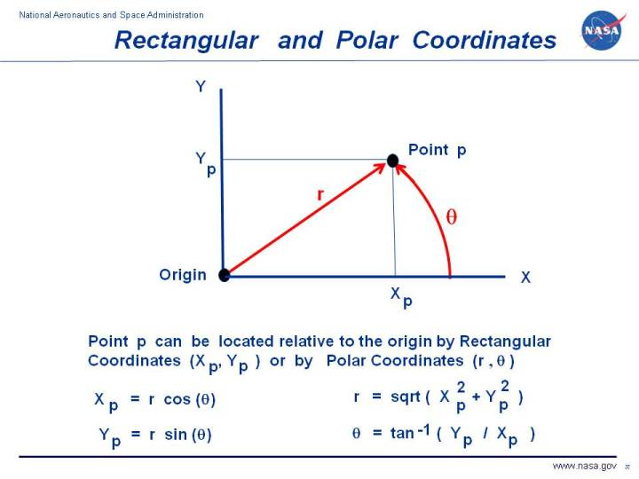
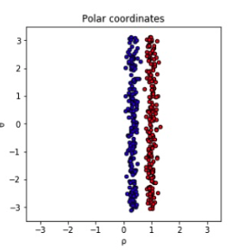
Feature Engineering

Slide 6
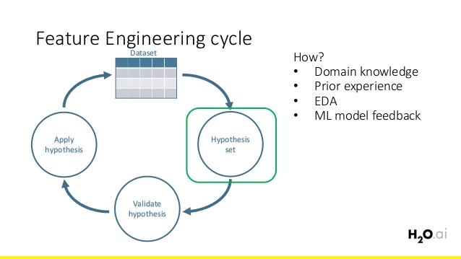
Why Feature Engineering?
Feature engineering efforts mainly has the goal of
Improving the performance of machine learning models.
Notes:
How to validate the hypotheses: CV, measuring desired metrics, avoid leakage
Why is it hard?
Feature transformation like target encoding can introduce leakage when applied wrong
Requires domain knowledge
Time-consuming, need to run thousands of experiments

Slide 7
Preprocessing vs Feature Engineering
Initial data collection
Creating the target variable
De-duplicating, imputation, fixing mislabeled classes, other data cleaning
Scaling or normalization
Feature selection
These are NOT feature engineering!

Slide 8
Feature Engineering Techniques
Target transformation
Feature Encoding
Feature Extraction
Remove irrelevant or noisy features

Slide 9
Feature Engineering Techniques
Extract new features, remove noisy or irrelevant data through:
Feature Selection
Target/Feature Transformation. Examples: log(x), sqrt(x)
Feature Encoding. i.e. turn categorical features into numeric features
Sklearn examples: LabelEncoder() (for tree models), OneHotEncoder()
Feature Interaction. Examples: X₁ + X₂, X₁²
Feature Extraction. Examples: Time, Location
Notes:
Target/feature transformation can improve model fit. For example when variable shows a skewed distruution make the residuals more close to normal dist
Feature Encoding: most ML models can only accept numbers as their input – also helps to explicitly capture non-linear relationships
Feature Interaction: the sum is greater than the parts?
Sum difference, product, division,
Housing price predictor, maybe size and location are interrelated … H-Statistics
Needs domain expertise
Feature Extraction: usually meaningful features inside existing features.
Feature Selection is the process where you automatically or manually select those features which contribute most to your prediction variable or output in which you are interested in. Having irrelevant features in your data can decrease the accuracy of the models and make your model learn based on irrelevant features

Slide 10
Feature Selection
The process where you automatically or manually select those features which contribute most to your prediction variable
Irrelevant or partially relevant features can negatively impact model performance.
Benefits:
Reduces overfitting
Improves accuracy
Reduces training time
Notes:
Feature Selection is one of the core concepts in machine learning
Feature selection and Data cleaning should be the first and most important step of your model designing.

Slide 11
Feature Selection Methods
Univariate Selection: Statistical tests can be used to select those features that have the strongest relationship with the output variable.
Feature Importance: feature importance property of the model
Correlation Matrix
Notes:
The scikit-learn library provides the SelectKBest class that can be used with a suite of different statistical tests to select a specific number of features.
Feature importance gives you a score for each feature of your data, the higher the score more important or relevant is the feature towards your output variable.
Feature importance is an inbuilt class
Correlation can be positive (increase in one value of feature increases the value of the target variable) or negative (increase in one value of feature decreases the value of the target variable)

Slide 12
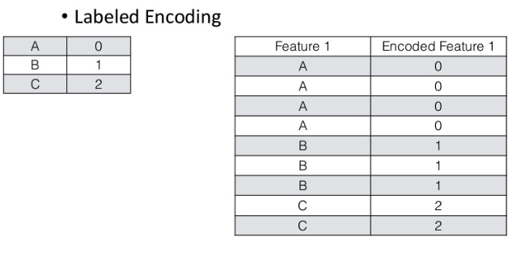
Feature Encoding – Categorical Variable

Slide 13
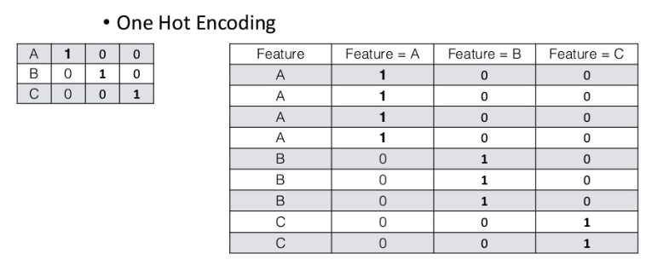
Feature Encoding - Categorical Variable

Slide 14
Feature Encoding - Numerical Variable
Binning. Example quantiles (same size population in each bin) or histograms (bins of same size)
Dimensionality reduction
Clustering and using cluster IDs or/and distances to cluster centers as new features

Slide 15
Feature Extraction – Textual Data
Bag of Words: extract tokens from text and use their occurrences (or TF/IDF weights) as features
Needs NLP techniques like N-grams, Stemming, etc.
Word Embeddings: Word2Vec, GloVe, BERT, ElMo, etc
Notes:
Machine learning algorithms cannot work with raw text directly; the text must be converted into numbers. Specifically, vectors of numbers.

Slide 16
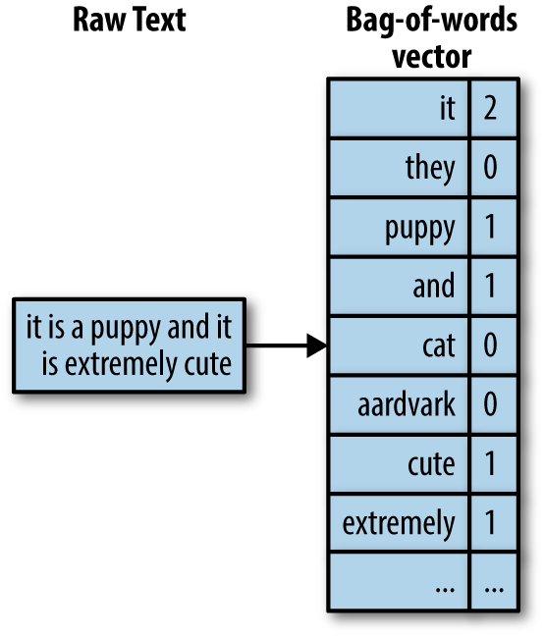
Feature Extraction – Textual Data - BoW
A vocabulary of known words
A measure of the presence of known words
Notes:
The approach is very simple and flexible, and can be used in a myriad of ways for extracting features from documents.
ignore case/punctuation

Slide 17
Feature Extraction – Textual Data - BoW
A vocabulary of known words
A measure of the presence of known words
What are the limits of this approach?

Slide 18
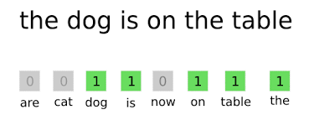
Feature Extraction – Textual Data - BoW
Notes:
It is called a “bag” of words, because any information about the order or structure of words in the document is discarded. The model is only concerned with whether known words occur in the document, not where in the document.
Frequent words that don’t contain much information like “a”
Misspelled words
Word variations: The goal of both stemming and lemmatization is to reduce inflectional forms and sometimes derivationally related forms of a word to a common base form.
Word meaning: Discarding word order ignores the context, and in turn meaning of words in the document (semantics). Context and meaning can offer a lot to the model, that if modeled could tell the difference between the same words differently arranged (“this is interesting” vs “is this interesting”), synonyms (“old bike” vs “used bike”), and much more.
Sparsity: Sparse representations are harder to model both for computational reasons (space and time complexity) and also for information reasons, where the challenge is for the models to harness so little information in such a large representational space.
OOV words

Slide 19
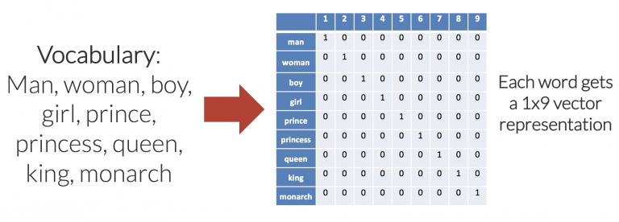
Textual Data – Word Embedding
Notes:
One-hot encoded example
Issues
* The number of dimensions (columns in this case), increases linearly as we add words to the vocabulary. For a vocabulary of 50,000 words, each word is represented with 49,999 zeros, and a single “one” value in the correct location. As such, memory use is prohibitively large.
* The embedding matrix is very sparse, mainly made up of zeros.
* There is no shared information between words and no commonalities between similar words. All words are the same “distance” apart in the 9-dimensional (each word embedding is a [1×9] vector) embedding space.

Slide 20
Questions?

